Slide 1
Social Network Influences on Adolescent Substance Use
Sunbelt
INSNA 2026
Daytona Beach, FL, USA

Slide 2
E-cigarette Cessation as a Disadoption Process: Social Network Influences on Stable and Temporary Quitting
Sunbelt
INSNA 2026
Daytona Beach, FL, USA

Slide 3
Authors
Anibal Olivera Morales, MSc
Kristina Miljkovic, MS
Yuchan, Cao, MPH
Sarah E. Piombo, PhD
Jessica Barrington-Trimis, PhD
University of Southern California
&
Thomas W. Valente, PhD

Slide 4
Acknowledgements
This work was partially supported by grant #R01-DA051843 from the National Institute of Drug Abuse (NIDA), the National Institutes of Health (NIH).
Feedback from members of the Center for Applied Network Analysis (CANA) at USC.

Slide 5
Data Collection
Wave | 1 | 2 | 3 | 4 | 5 | 6 | 7 | 8
Time | Fall 2020 | Spring 2021 | Fall 2021 | Spring 2022 | Fall 2022 | Spring 2023 | Fall 2023 | Spring 2024
Grade-C1 | 9th | 9th | 10th | 10th | 11th | 11th | 12th | 12th
Grade-C2 |  |  | 9th | 9th | 10th | 10th | 11th | 11th
N Schools | 5 | 11 | 14 | 14 | 14 | 14 | 14 | 14
N Students | 852 | 2,240 | 3,525 | 3,539 | 3,379 | 3,123 | 2,097 | 1919
No. of schools/networks | 100 | 11 Unique Schools
No. of students | 23,012

Slide 6
Network Question (Roster Pre-loaded)
Name up to seven (7) of your closest friends in your grade at school in the spaces below. Enter your friend's first and last real name, not their nickname. For example, if you call your friend “Tony” but his real name is “Anthony Smith,” enter “Anthony Smith.” As you enter the first few letters of their first name, possible choices will automatically appear on the screen. Please select the friend you want to name. If no name matches, just enter the name you wish to enter.

Slide 7
Outcomes:
Past 6-month use of E-cigarettes
Also assessed Ever-use
Also asked about other substances …

Slide 8
Covariate Controls
Grade in school
Cohort (2025 vs. 2024)
Female identity
Sexual minority
Financial precariousness
Latine identity
Asian

Slide 9
Results: Demographics
% Female | 52.3
% Financial Precariousness | 39.4
% Sexual Minority | 6.8
Parental Education | 4.85
% Latine | 44.3
% Other | 33.4
% Asian | 34.5
% Multi | 17.9
% White | 14.2

Slide 10
Network Data
Perceived Use Somewhat Higher than Friend Self-report
 | Mean | Standard Deviation | Range
Out Degree (# friends named) | 2.58 | 1.97 | 0 - 7
In Degree (# times named as friend) | 2.58 | 2.21 | 0 - 16
# Friends Self-report E-cigarette Use | 0.34 | 0.69 | 0 - 5
# Friends Self-report Marijuana Use | 0.23 | 0.58 | 0 - 6
# Friends Self-report Alcohol Use | 0.58 | 0.93 | 0 - 6
# Friends Self-report Any | 0.38 | 1.95 | 0 - 17
# Friends Perceived Use E-cigarettes | 0.48 | 1.07 | 0 - 5
# Friends Perceived Use Marijuana | 0.47 | 1.11 | 0 - 5
# Friends Perceived Use Alcohol | 0.72 | 1.35 | 0 - 5
# Friends Perceived Use Any | 0.57 | 1.04 | 0 - 5

Slide 11
Exposure is Associated with Adoption
A
B
F
Ego
C
E
D

Slide 12
Networks
 | E-cigarette | Marijuana | Alcohol | Any
Out-degree | 0.73* | 0.79* | 0.81* | 0.87*
In-degree | 0.97 | 0.99 | 0.93 | 0.97
# Friends Self-report Use | 2.08* | 2.38* | 1.83* | 1.44*
# Friends Perceived Use | 1.67* | 1.94* | 1.51* | 2.14*
# Asian Friends Named | 0.69 | 0.53 | 0.70 | 0.68
# Named as Friend by Asians | 0.38* | 0.29* | 0.55* | 0.42*

Slide 13
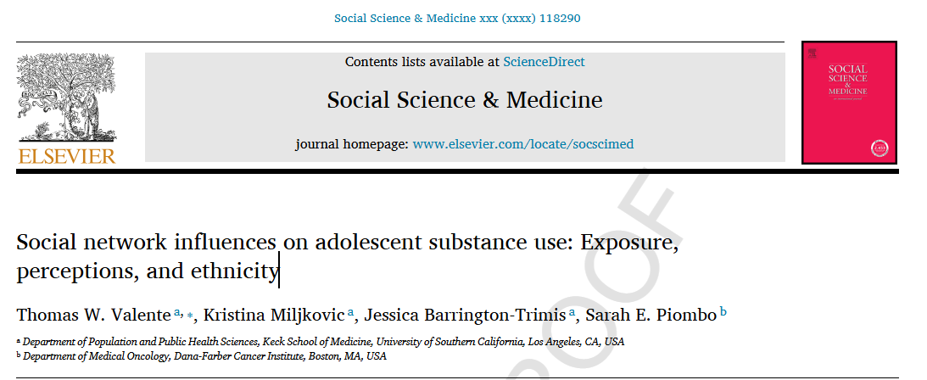

Slide 14
Quitting
Many studies have shown that individual substance use is associated with peer use.
Much less frequently studied is quitting or dis-adoption
Stable quitting, Use Quit
Temporary quitting, Use Quit …
Unstable quitting, Use Quit Use

Slide 15
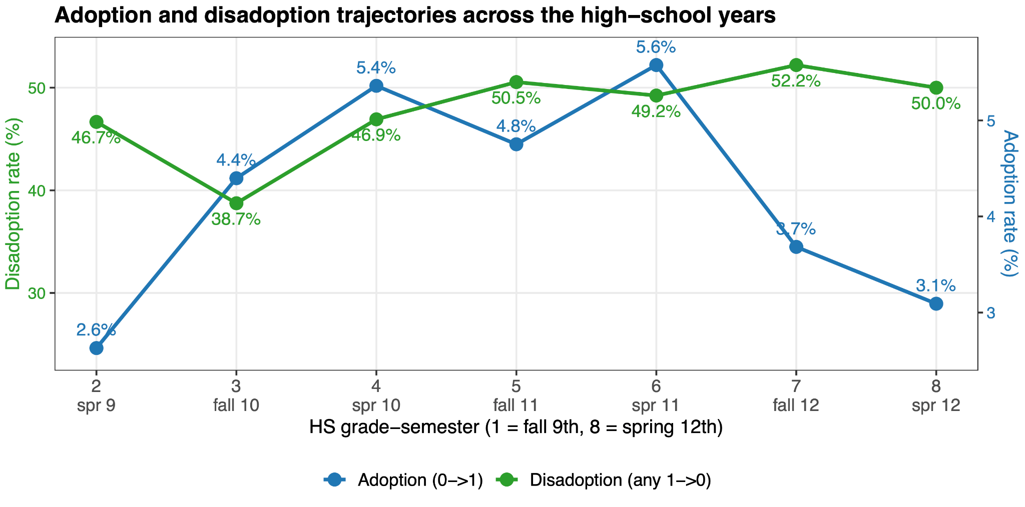

Slide 16
Past 6-Month E-cigarette Use
 | Adopters | Stable Quitters | Temporary Quitters | Unstable Quitters
N Students | 1,711 | 161 | 182 | 161
N Events | 193 | 89 | 129 | 15
Sexual Minority | 1.45* | 0.68 | 0.84 | 1.24
Asian | 0.64* | 0.91 | 0.98 | 0.35
Major Depressive Symptoms | 1.17 | 0.74 | 0.44* | 0.21*
Generalized Anxiety Disorder | 0.87 | 1.43 | 1.20 | 1.36
Out-degree | 0.91 | 1.18 | 0.94 | 0.91
In-degree | 1.10* | 1.09 | 1.13 | 1.07
Perceived Friend Use (N) | 1.47* | 0.73* | 0.72* | 0.78
Network Exposure Users | 5.68* | 0.10* | 0.23* | 0.80
Network Exposure Disadopters | 1.81 | 0.37 | 0.40 | 0.04

Slide 17
Quit rates as a function of the number of perceived friends who vape
# Perc. Friends | At Risk for Use | N Users | Use Rate | N at Risk for Quitting | N Quitters | Quit Rate
0 | 17492 | 376 | 0.0215 | 388 | 210 | 54.12%
1 | 2067 | 106 | 0.0513 | 224 | 95 | 42.41%
2 | 1246 | 111 | 0.0891 | 247 | 77 | 31.17%
3 | 652 | 62 | 0.0951 | 223 | 61 | 27.35%
4 | 214 | 20 | 0.0935 | 127 | 27 | 21.26%
5 | 269 | 31 | 0.1152 | 193 | 40 | 20.73%

Slide 18
Quit rates as a function of the number of network ties who vape
# Network Friends | At Risk for Use | N Users | Use Rate | N at Risk for Quitting | N Quitters | Quit Rate
0 | 12223 | 384 | 0.0314 | 537 | 280 | 52.14%
1 | 2024 | 154 | 0.0761 | 285 | 130 | 45.61%
2 | 342 | 31 | 0.0906 | 91 | 34 | 37.36%
3 | 45 | 6 | 0.1333 | 17 | 5 | 29.41%
4 | 6 | 1 | 0.1667 | 5 | 2 | 40.00%
5+ | 1 | 0 | 0 | 2 | 0 | 0.00%

Slide 19
Conclusions
Use was associated with peer use as usual
No Demographic variables were associated with quitting either stable or temporary
Major depressive symptoms was associated with temporary quitting

Slide 20
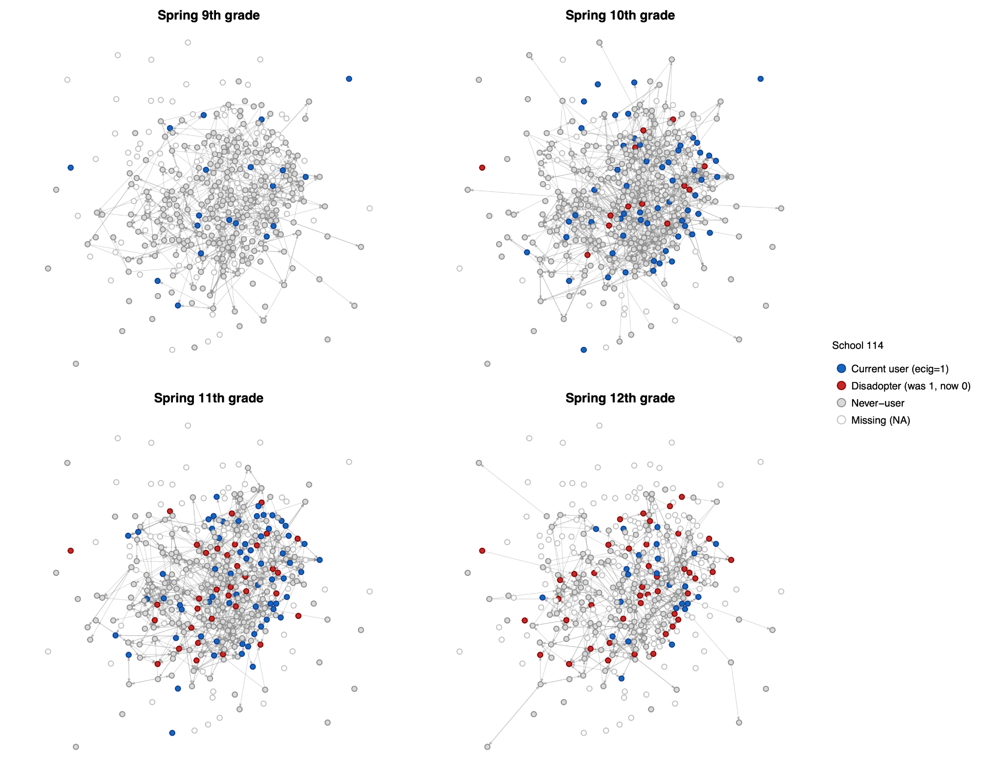

Slide 21
Conclusions (2)
Both perceived network friend use were inversely associated with quitting whether stable or temporary
Exposure to quitters (disadopters) was not associated with quitting

Slide 22
Discussion
This suggests that teens will continue using e-cigarettes when their friends use them but will discontinue if they do not have continued support to use

Slide 23
Thank You!

Slide 24
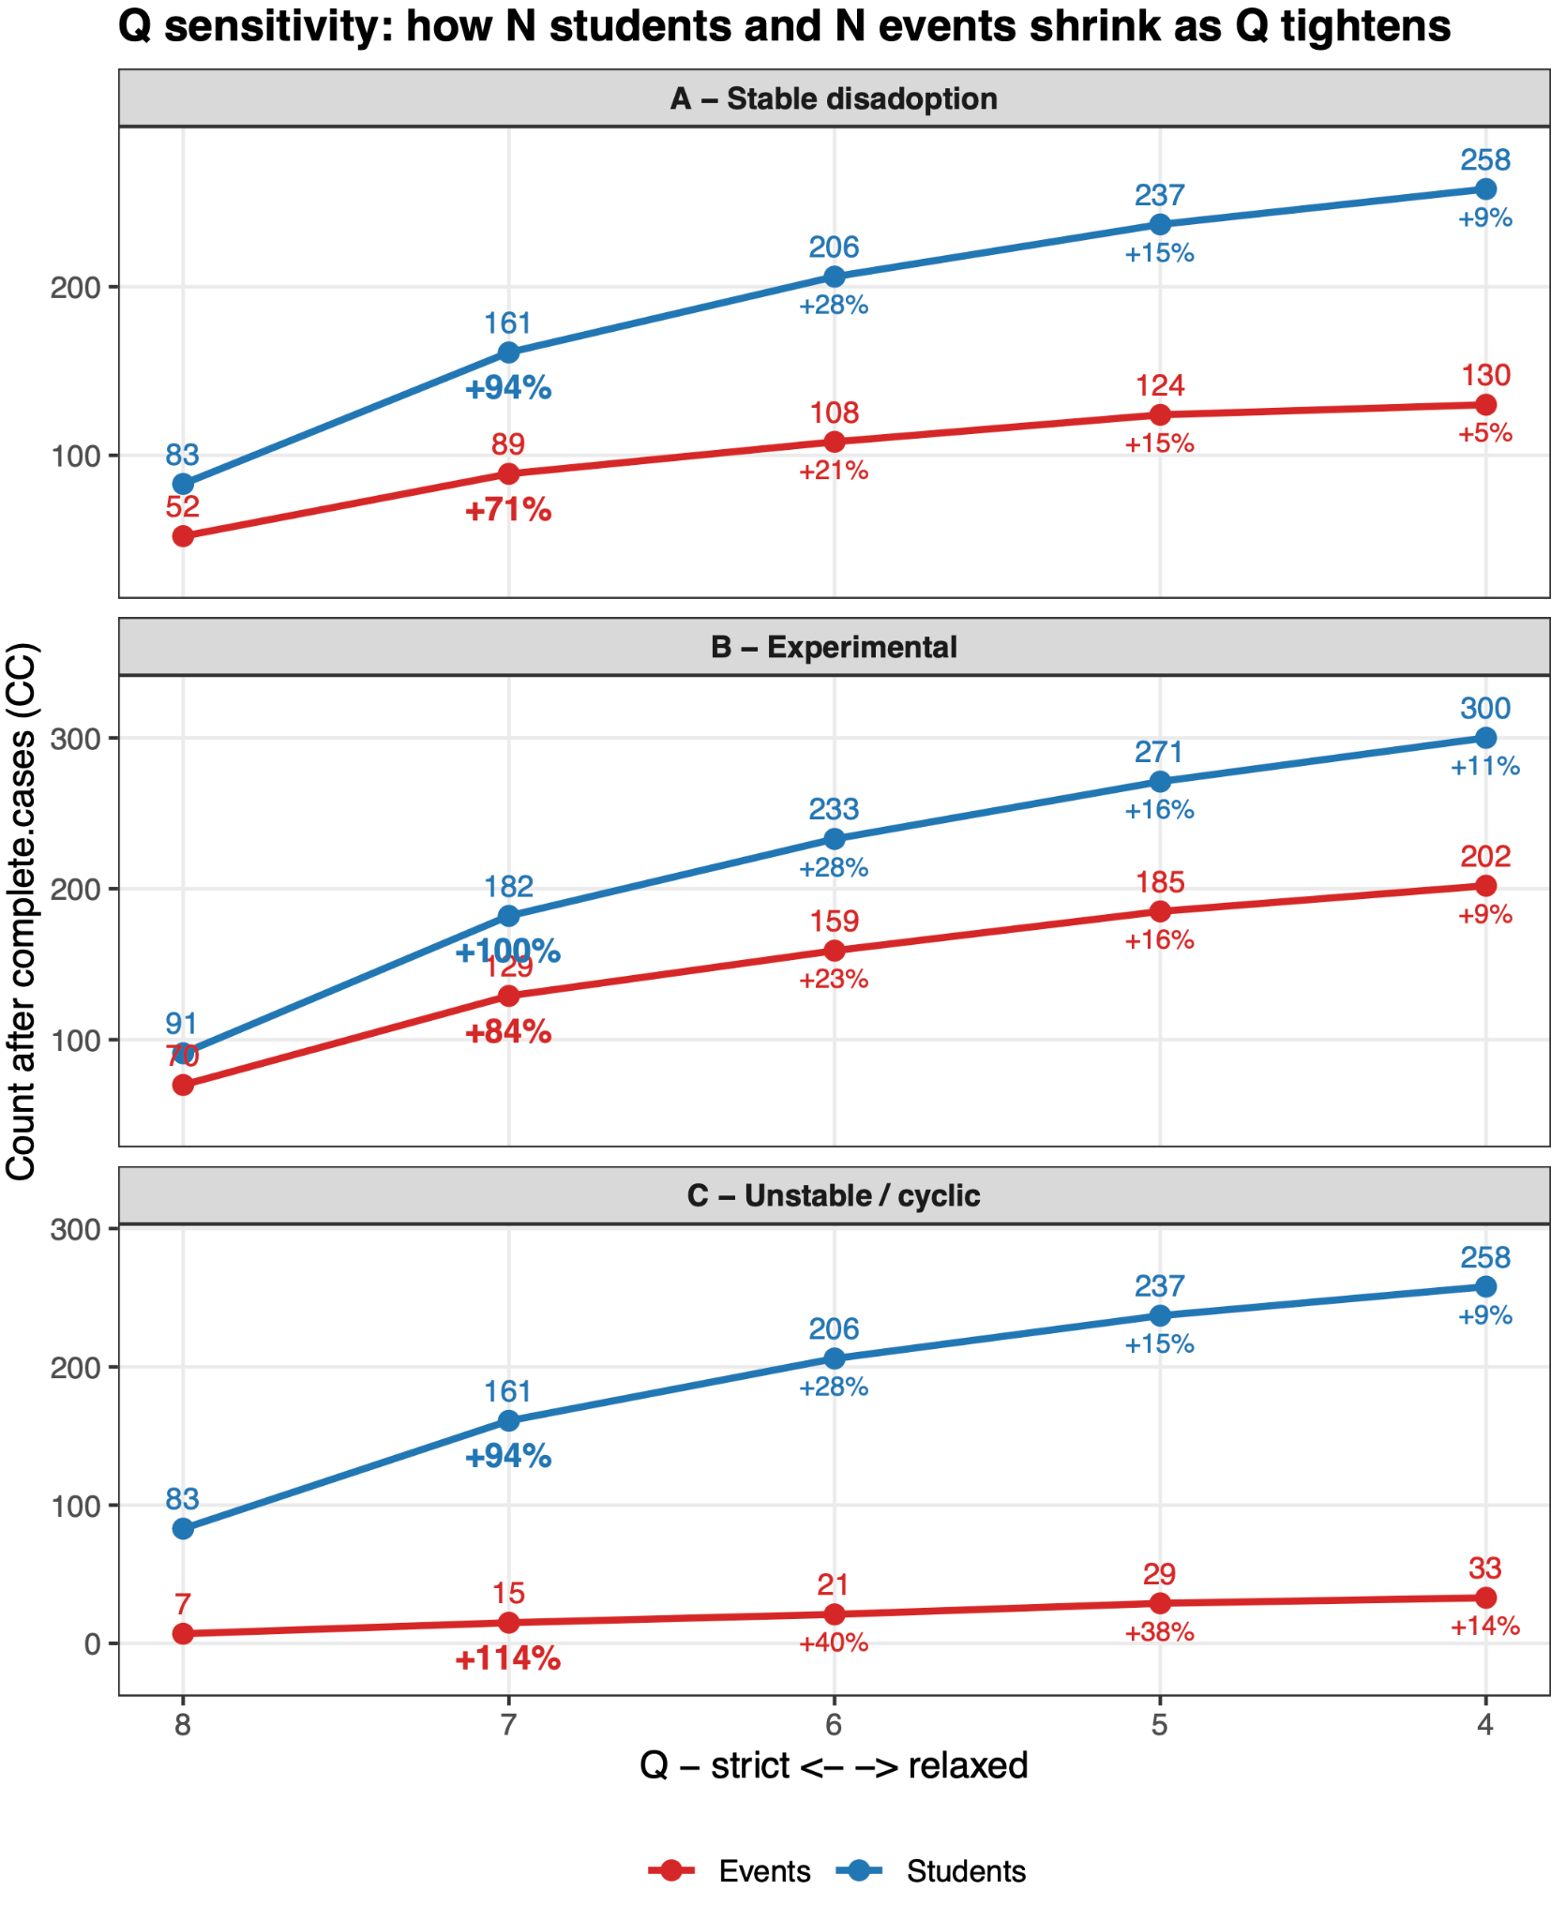

Slide 25
Past 6-Month E-cigarette Use
 | Adopters | Stable Quitters | Temporary Quitters | Unstable Quitters
N Students | 1,711 | 161 | 182 | 161
N Events | 193 | 89 | 129 | 15
Sexual Minority | 1.45* | 0.68 | 0.84 | 1.24
Asian | 0.64* | 0.91 | 0.98 | 0.35
Major Depressive Symptoms | 1.17 | 0.74 | 0.44* | 0.21*
Generalized Anxiety Disorder | 0.87 | 1.43 | 1.20 | 1.36
Out-degree | 0.91 | 1.18 | 0.94 | 0.91
In-degree | 1.10* | 1.09 | 1.13 | 1.07
Perceived Friend Use (N) | 1.47* | 0.73* | 0.72* | 0.78
Network Exposure Users | 5.68* | 0.10* | 0.23* | 0.80
Network Exposure Disadopters | 1.81 | 0.37 | 0.40 | 0.04

Slide 26
Asian Students More Susceptible to Peer Influence
Table 4. Adjusted odds ratios for peer influences on substance use separately by Asian and Non-Asian Students.†
 | E-cigarette | Marijuana | Alcohol | Any
Asian Students
# Friends Self-report Use | 2.83** | 4.67** | 2.23** | 5.34**
# Friends Perceived to Use | 1.96** | 3.03** | 2.03** | 2.91**
Non -Asian Students
# Friends Self-report Use | 1.84** | 2.20** | 1.84** | 2.90**
# Friends Perceived to Use | 1.63** | 1.88** | 1.45** | 2.16**
Wald Test Z Scores
# Friends Self-report Use | 1.70* | 2.46** | 1.12 | 2.03*
# Friends Perceived to Use | 1.19 | 2.61** | 2.96** | 1.74*

Slide 27
Additionally
Results replicated on past 6 months use
Results did not differ by whether the school was Asian majority.

Slide 28
Other Publications
Piombo, S. E., Vega Yon, G., & Valente, T. W. (2025). The impact of social norms on diffusion dynamics: A simulation of e-cigarette use behavior. Health Education and Behavior, 00, doi:10.1177/10901981251327189
Piombo, S. E., de la Haye, K., & Valente, T. W. (2025). Network dynamics of social influence on e-cigarette use among an ethnically diverse adolescent cohort. Nicotine and Tobacco Research, 00,
Piombo, S. E., Barrington-Trimis, J., & Valente, T. W. (2023). Network norms and individual electronic nicotine delivery systems use. BMC Public Health.

